Slide 1
Fat, cholesterol, calorie and food label notes

Slide 2
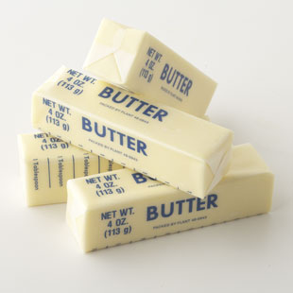
Saturated fats
When the acid holds all the hydrogen atoms that it can, it is considered saturated.
Tropical oils have a lot of saturated fats
i.e. palm oil, coconut oil
Animal fats have a lot of saturated fats
i.e. beef, pork, egg yolks, dairy
Saturated fats are solid or semi-solid at room temperature
A lot of saturated fat in your diet can lead to
increased risk for heart disease

Slide 3
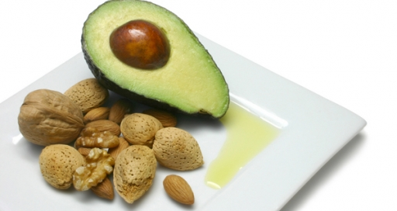
Unsaturated fats
When it is missing one or more pairs of hydrogen atoms is it considered unsaturated fat.
Most vegetable fats have a higher proportion of unsaturated fats
Olive, Canola, Soybean
These fats are liquid at room temperature
Be careful and look for trans fats- HYDROGENATION is the adding of missing hydrogen atoms that makes the fat more saturated.
i.e. margarine

Slide 4
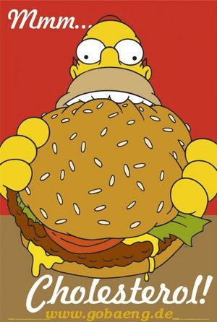
cholesterol
Cholesterol is a fat like substance produced in the liver of animals.
It is ONLY found in foods of animal origins.
Your body needs some cholesterol because it helps with the production of sex hormones, Vitamin D, and the protective sheath around nerve fibers.
High cholesterol is a risk factor for heart and
Other circulatory diseases.
Consumption of fat, especially saturated fats,
raises blood cholesterol levels.

Slide 5
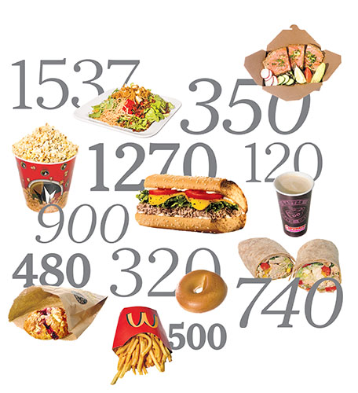
calories
What is a calorie?
The amount of energy needed to raise the temperature of 1 gram of water by 1°C.
Basically….. The amount of energy in a food.
The amount of calories you need depends on your age, gender, and activity level.
High school students need between
1,800 and 3,200 calories per day.
Use your daily calories to get the
nutrients you need from the food
groups to keep your body strong.

Slide 6
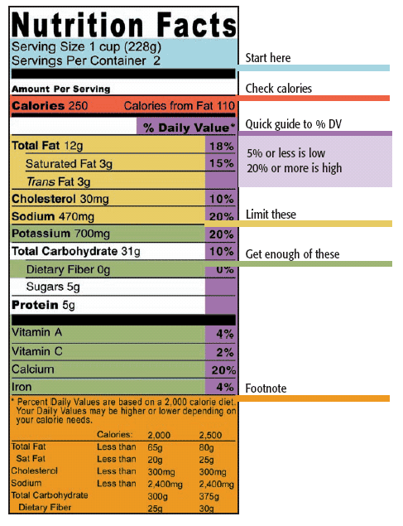
Food labels
Food Labels can help you:
Choose foods that are low in fats,
sugar, and salt
Compare the nutrient content of
different foods
Identify recommended serving sizes
Identify calories per serving
When looking at the % daily value,
5 % and below is low in nutrients
and 20% and higher is
considered high in nutrients.

Slide 7
Food label proposed changes

Slide 8
Food label changes
What differences did you notice between the old label and the proposed label? What is missing? What is added?
How do you think the proposed changes will help consumers make better decisions?
Would you change anything else on the label to make it better?

